Slide 1
Program Control
by
Prof. Upendra Mishra
KIET Group of Institutions, Delhi-NCR, Ghaziabad

Slide 2
Contents
Introduction
Types of Program Control
Description
Conclusion

Slide 3
Introduction
Program control is how a program makes decisions or organizes its activities.
It typically involves executing particular code based on the outcome of a prior operation or a user input.
Program Control Instructions are the machine code that are used by machine or in assembly language by user to command the processor act accordingly.

Slide 4
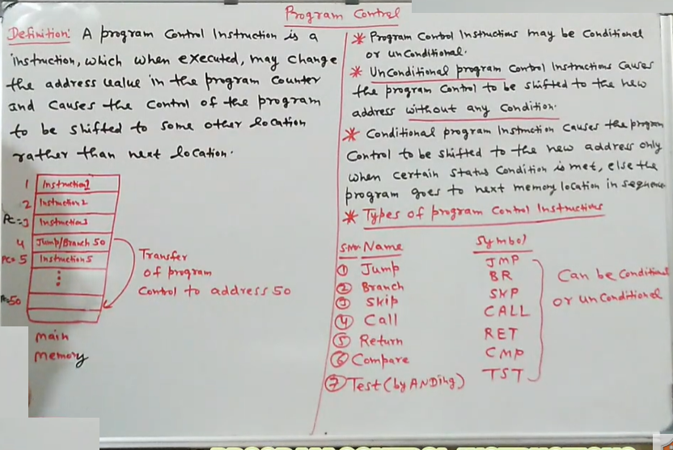

Slide 5
Types of Program Control
Compare Instruction
Unconditional Branch Instruction
Conditional Branch Instruction
Subroutines
Halting Instructions
Interrupt Instructions

Slide 6
Compare Instruction
Similar to subtract instruction, but the result is not stored anywhere.
Flags are set according to the result.
Example: CMP R1,R4 ;

Slide 7
Unconditional Branch Instruction
Causes an unconditional change of execution sequence to a new location.
Example: JMP L1
Instructions Used: JNZ, JZ, JC, JS etc.

Slide 8
Conditional Branch Instruction
Used to examine the values stored in the condition code register.
Determines whether the specific condition exists and to branch if it does.
Example:
  Assembly Code : BNE R2, R3, L2
  High Level Code: if (x!=y) goto L2;

Slide 9
Subroutines
A subroutine is a program fragment that lives in user space, performs a well-defined task.
It is invoked by another user program and returns control to the calling program when finished.
Example: CALL and return Instructions.

Slide 10
Halting Instructions
To stop execution of program.
NOP: No operation.
HALT: Remaining in an idle state until restarted by interrupt, trace, reset or external action.

Slide 11
Interrupt Instructions
Mechanism by which an I/O or an instruction can suspend the normal execution of processor and get itself serviced.
Example: TRAP, RESET,INTR etc.

Slide 12
Conclusion
Program Control Instructions are the machine code that are used by machine to command the processor.
There are 6 common and mostly used types of Program Control Instructions.
Control instructions are written in Assembly language by users to control the processor.

Slide 13
Thank
You

